Slide 1
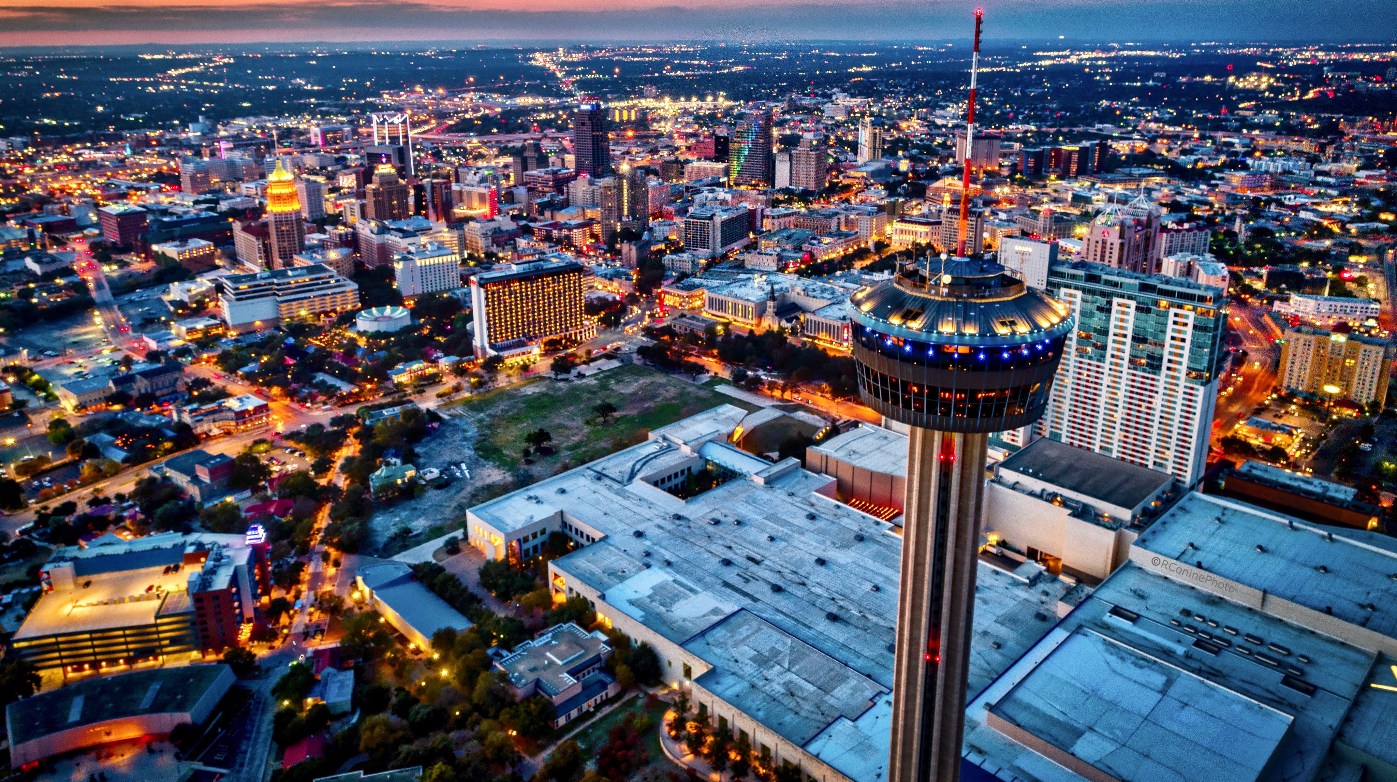

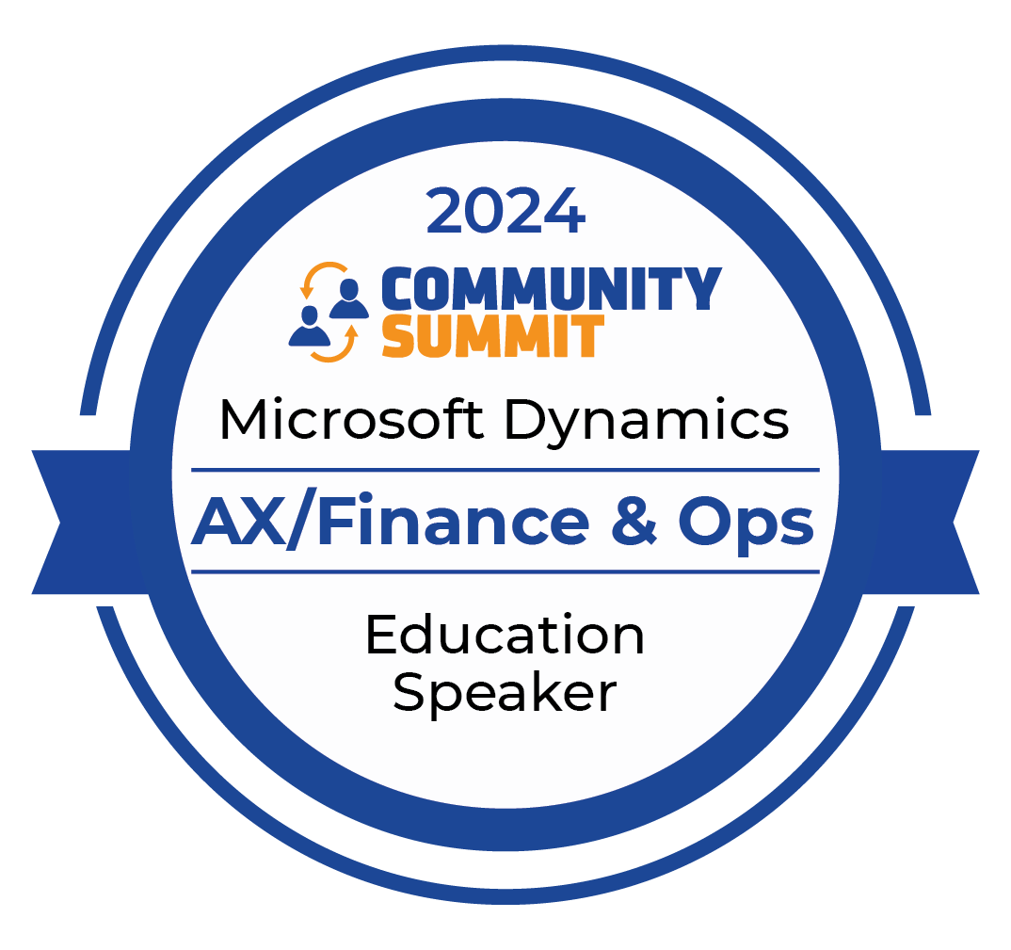
AX/FINANCE & OPS
San Antonio, Texas
October 13-17, 2024

Slide 2
Empowering Dynamics 365 for Finance and Operations with AI: A Transformational Journey

Slide 3


Nathan Clouse
Technical Architect
Armanino LLP
Email: nathan.clouse@armanino.com
Blog #1: https://www.atomicax.com
Blog #2: https://www.dynamics.fo
GitHub: https://github.com/NathanClouseAX
@NathanClouseAX on most platforms
Background:
Awarded Microsoft MVP in Business Applications since 2019
Been working with AX since 2009
Been working with D365FO since 2017
Have spoken at Summit, Focus, and local chapters around various AX/D365FO technical topics plus other groups events

Slide 4
Fundamentals of AI
AI for D365
Copilot
Copilot Studio
Strategies for Implementation and Value

Slide 5
What is AI?
Artificial intelligence is a field of science concerned with building computers and machines that can reason, learn, and act in such a way that would normally require human intelligence or that involves data whose scale exceeds what humans can analyze.

Slide 6
What’s that actually mean?
AI systems work by ingesting large amounts of labeled training data, analyzing that data for correlations and patterns, and using these patterns to make predictions about future states.

Slide 7
Machine Learning (ML)
A method of data analysis that automates analytical model building. ML is based on the idea that systems can learn from data, identify patterns, and make decisions with minimal human intervention.

Slide 8
ML Examples
Product Recommendations
Match you to a “profile” – X axis
Match that profile to products – Y axis
“profile” is the Z axis
Email Spam Filtering
Identify text anomalies
Separate out “junk”

Slide 9
Natural Language Processing
The ability of a computer to understand, interpret, and generate human language, including speech and text.
ChatGPT, Copilot, etc.
Search Results, Predictive Text

Slide 10

Computer Vision
Enabling machines to interpret and make decisions based on visual input from the world, like identifying objects in an image or video.

Slide 11
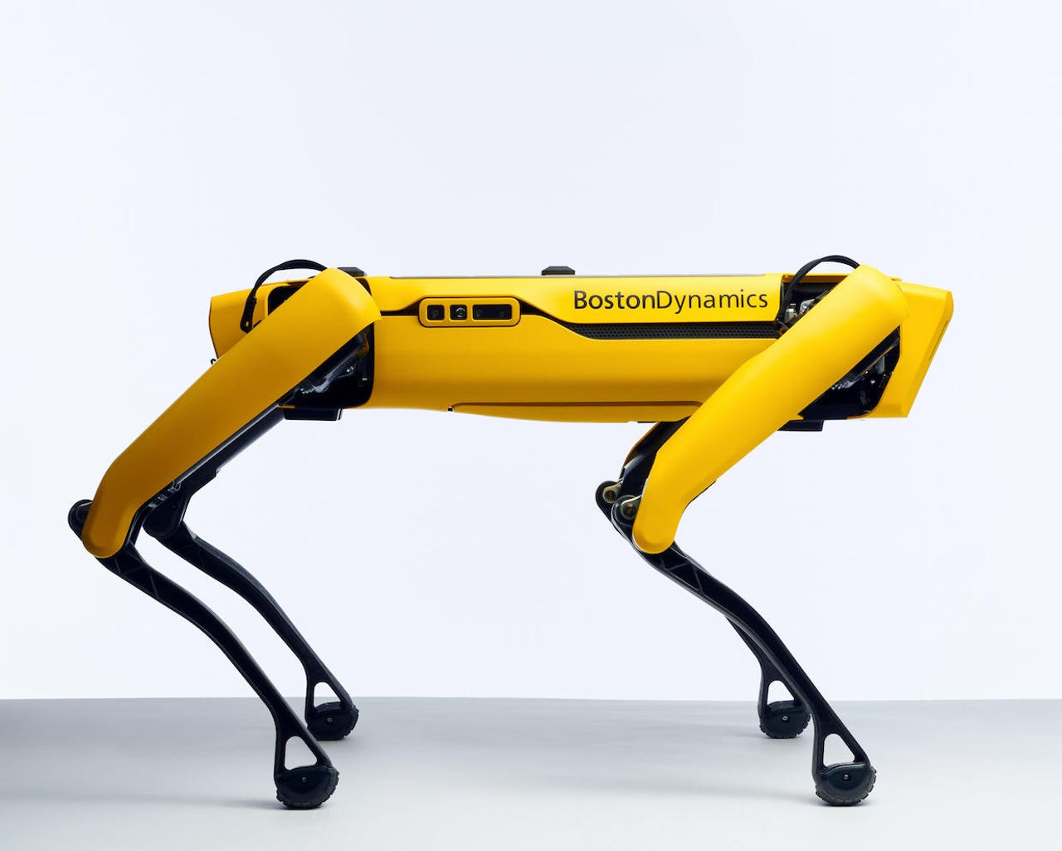
Robotics
The branch of AI that involves the design and operation of robots, which are often powered by AI algorithms to perform tasks autonomously or semi-autonomously.
Robot Vacuums, etc

Slide 12
Expert Systems
AI programs that mimic the decision-making ability of a human expert, often used in fields like medicine or finance.
MRP

Slide 13
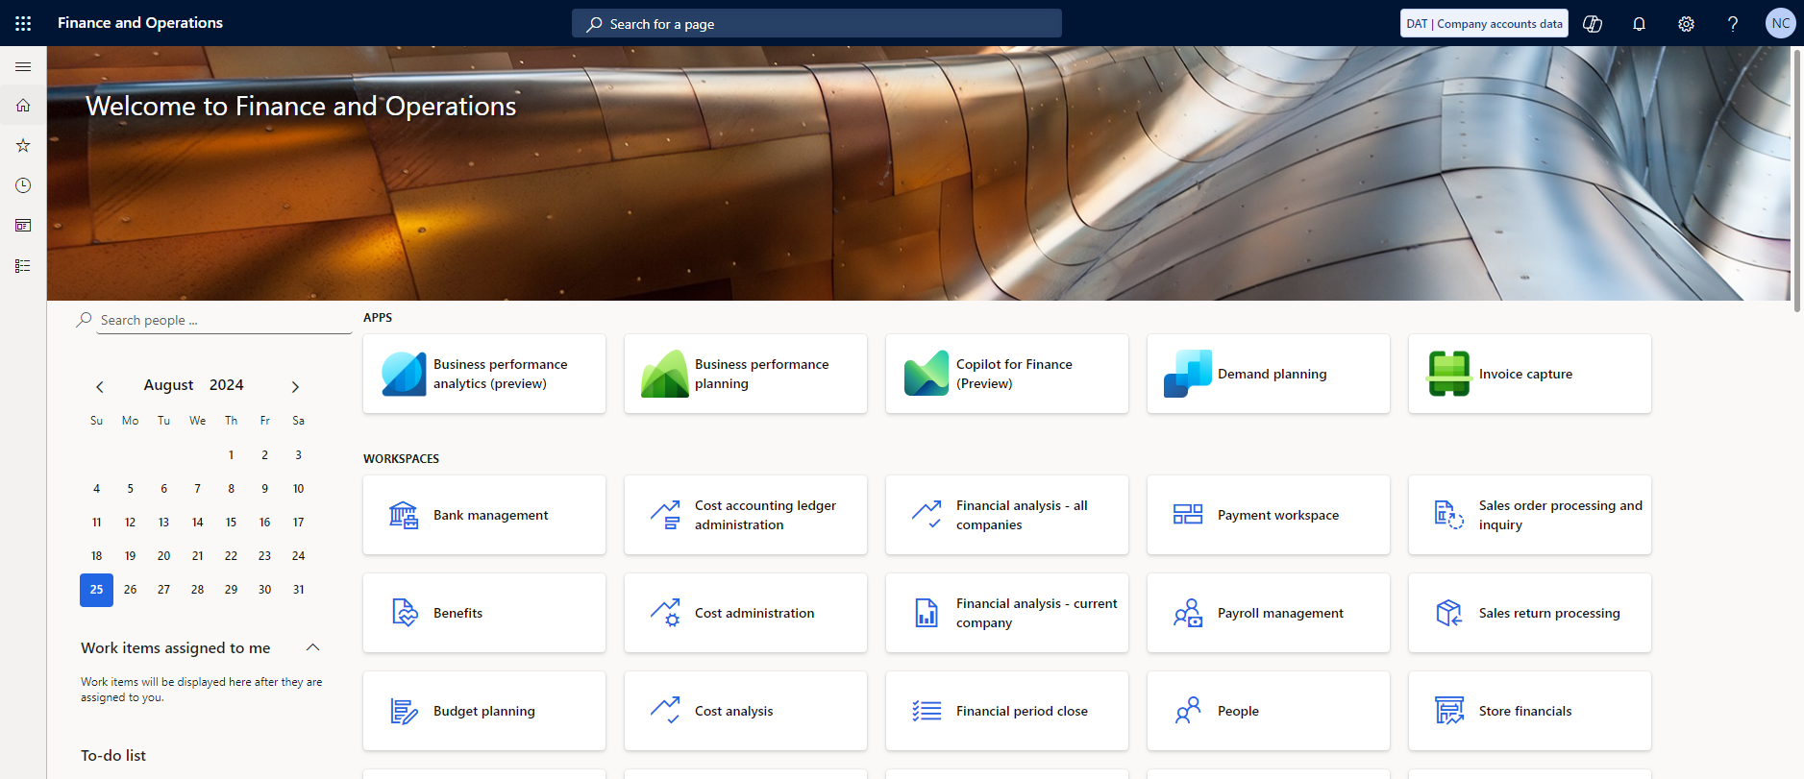
What AI Do I already Have?

Slide 14
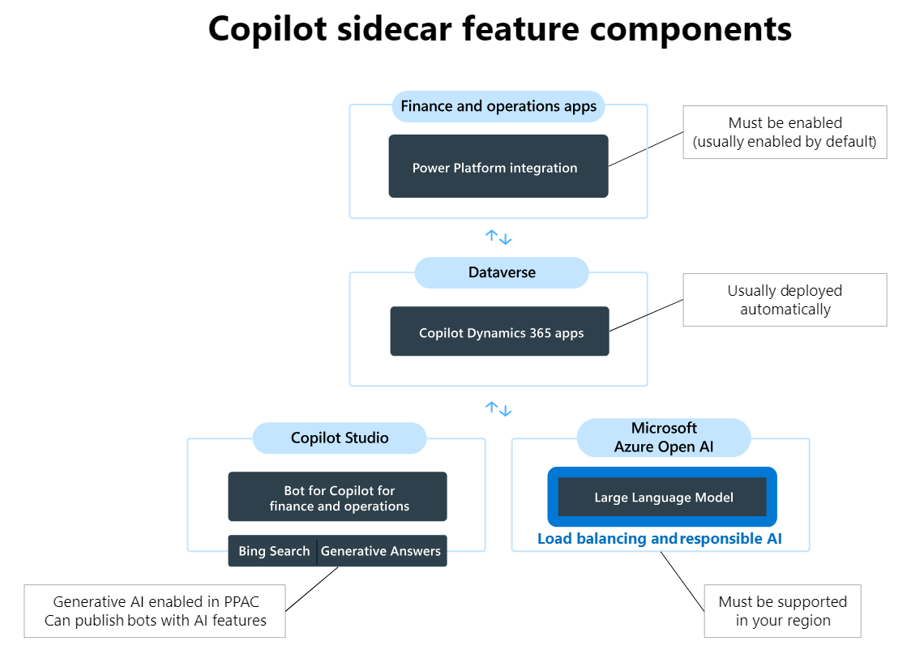
“Sidecar”

Slide 16
“Sidecar”

Slide 17
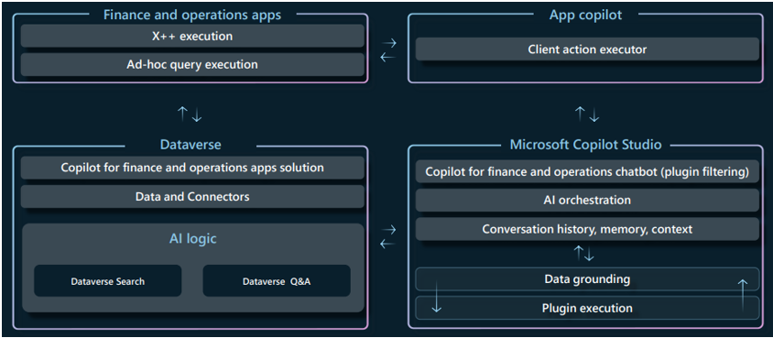
X++ “Skills”

Slide 18
X++ “Skills”

Slide 19
X++ “Skills”

Slide 20
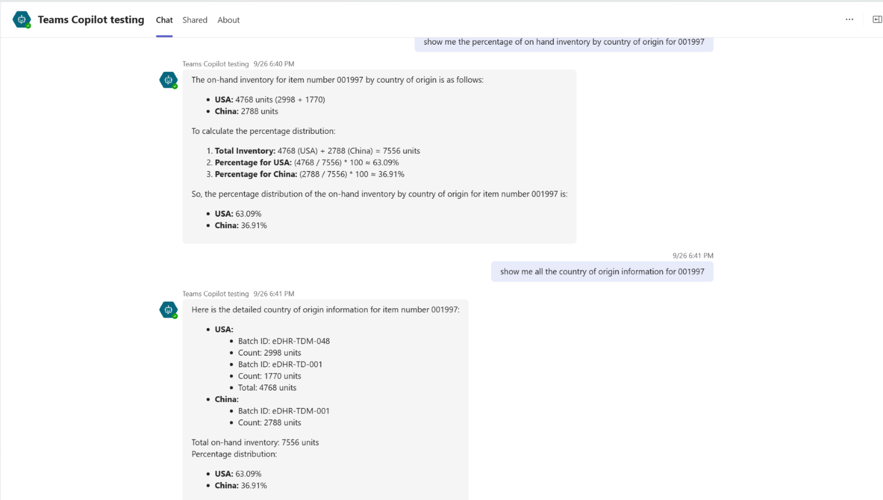
Example

Slide 22
Example

Slide 23
Strategies
Enhanced Decision-Making
Increased Efficiency and Productivity
Personalization and Customer Experience
Risk Management and Compliance
Others?
Notes:
Use context suggestions to enhance decision – ie; vendor quality has declined recently, scan for public knowledge updates – ie sale, some negative event
Automation workflows and raise exceptions
Use bots or agents to collect commodity or transaction info
Profile transactions and point out anomolies

Slide 24
Please Fill Out Survey!

Slide 25
AX/FINANCE & OPS
© 2024 Dynamic Communities. All rights reserved.

